Slide 1
October Count
2023
9/25 – 10/9

Slide 2
What is October Count?
Official Count Day October 2nd
Count of students that meet requirements to be funded by CDE
Approx. $8000 per student
Count Window 9/25 – 10/9
A student MUST have a schedule and attendance ON OR BEFORE 10/2 in order to be counted.

Slide 3
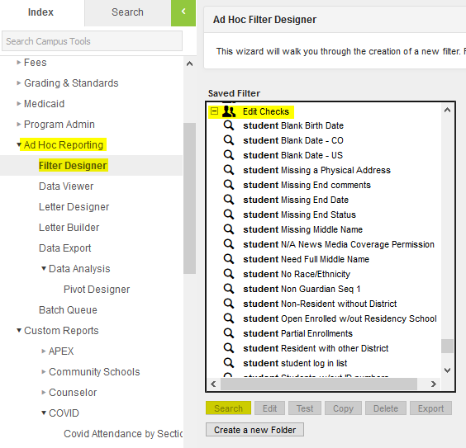
TO DO
-Withdraw any no-shows
-Start keeping track of part-time students, weird situations, etc.
-Check that all students have classes/schedules
*Use Student Gap Scheduler (found under scheduling)
*Check Semester 1
- Q1 AND Q2
- T1 AND T2
-Clean Edit Checks
*Residency Clean Up – all non-residents need a District
*Missing Race/Ethnicity

Slide 4
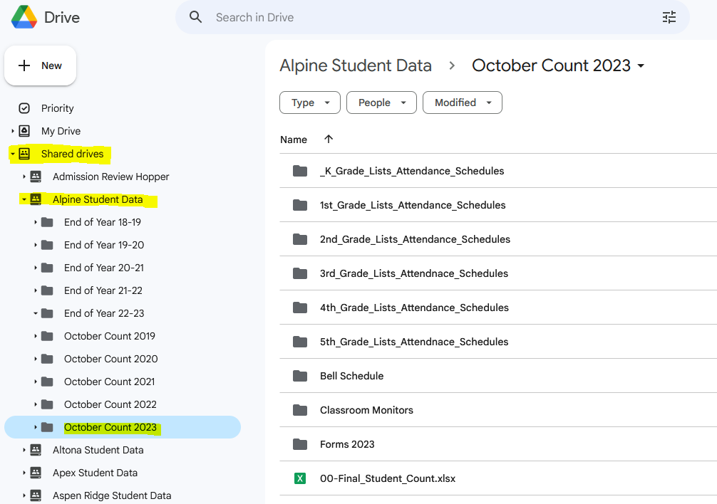
School Documentation
All documentation is saved in
Google Drive > Shared drives > School Folder > October Count 2023

Slide 5
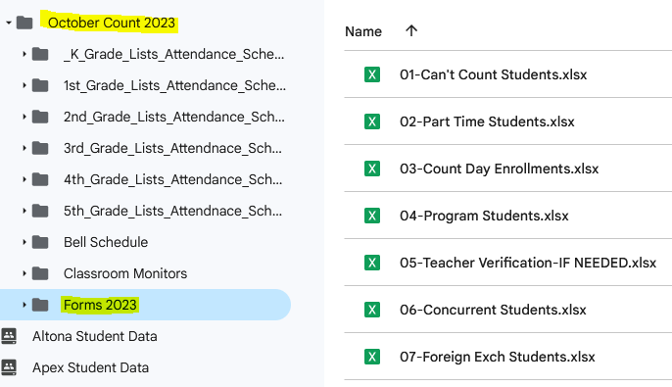
Forms
These are your forms to modify directly in Google Drive. Please complete them right here in this folder.

Slide 6
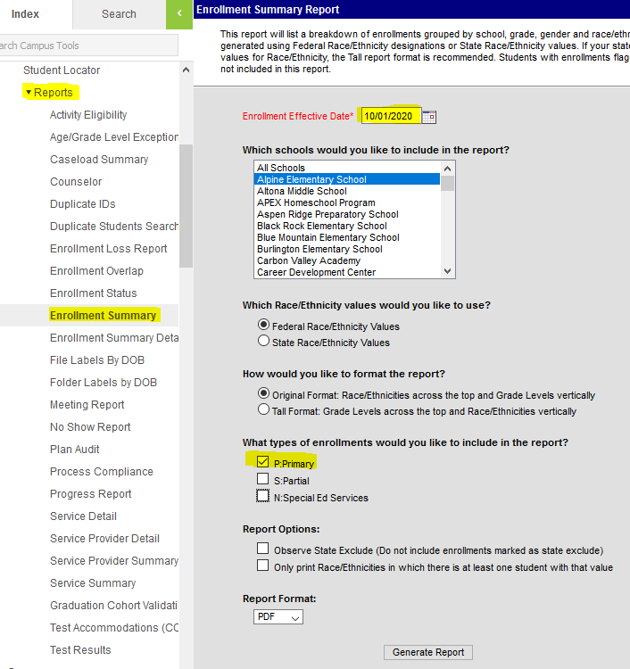
On Count Day – October 2nd
Enroll students immediately! No 48 hour hold unless a serious safety issue!
Generate all reports according to Instructions,
“1-Count Day – To Do”
10/02/2023
#1 – Generate Lists by Alpha and Race
Follow instructions on October Count Day Reports Handout #1
Run Lists of students by Alpha and Race from AdHoc Reporting
Save lists in their appropriate grade level folders
#2 – Run Enrollment Summary:
Expand Student Information
Expand Reports
Select Enrollment Summary
Make sure the Enrollment Effective Date is set to 10/02/2023
Uncheck the Service Types S:Partial & N:Special Ed Services
Click Generate Report

Slide 7
Attendance
A student can be counted if:
they attend on Oct. 2nd
they attend if the 5 days preceding Oct. 2nd AND within the 5 days following Oct. 2nd
they attend at all prior to Oct. 2nd AND resume attendance by the end of October
We need student specific attendance detail in this case
Teachers must take 100% complete & accurate attendance each and every day
Generate and Save the Classroom Monitor each day 9/25 – 10/9
Needs to be blank EVERY DAY

Slide 8
Attendance Register
Generate Attendance Register according to Instructions,
“2-Attendance Register–October Count 2023”
On October 10th the Register should be Saved into each grade folder
Date Range: 9/25 – 10/9
Enrollment effective date of 10/2
Repeat for EACH GRADE LEVEL
Review this report for students that missed Count Day
Do they have attendance before AND after?
If they do not have attendance before AND after count day,
Generate their Period Detail from their attendance tab for the year.
Save it in their grade folder titled with their name.

Slide 9
Schedules
A Student must be scheduled for the entire
1st Semester = 1st and 2nd Quarters/Trimesters.
Full Time Membership
360 Hours/Semester = 250 minutes per day
Part Time Membership
90 Hours/Semester = 65 minutes per day
Schedules NEED to be reviewed prior to October 2nd
Schedules are expected to meet FT membership
Every student schedule must be checked!
Work Study – Must have Contract if it’s the 6th class
Independent Study – we can only count the time spent with an instructor.

Slide 10
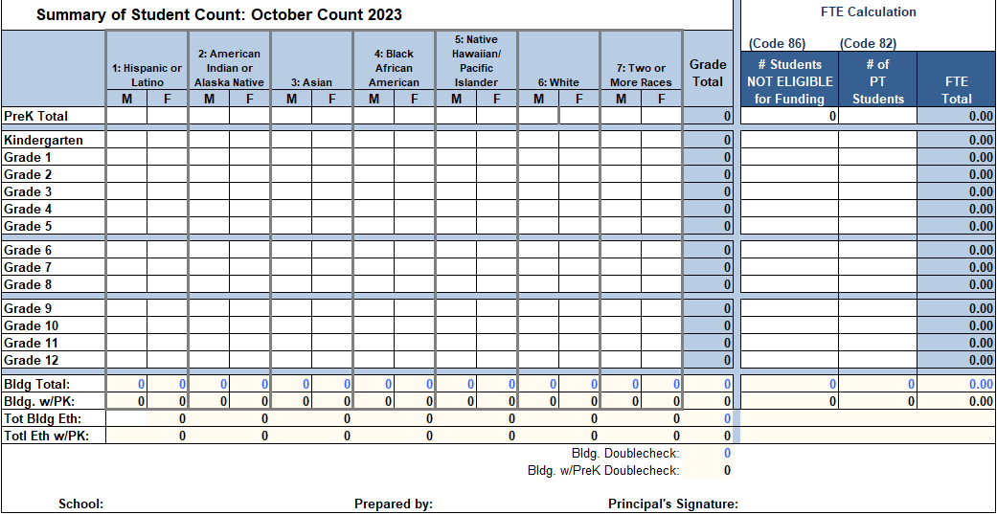
How Does it all come together?
Enrollment Summary Numbers are entered into the Final Count Spreadsheet
The total by grade should match the total Listed by Alpha, Listed by Race, Attendance Register and Schedules
Then, it’s determined who is part-time and who is not eligible to be counted based on schedules and attendance.
These names are listed on forms 1 & 2
The counts by grade are entered on the right side of the spreadsheet.
4-Final Count Summary Instructions

Slide 11
AUDITS
October 10th – October 19th
All audits will be held at our office:
619 Bowen St.
Elementary Schools Sign Up Here
Secondary Schools Sign Up Here

Slide 12
HOMEWORK
Make sure you can get to the Share Drive
Make sure you can click into your school folder
Familiarize yourself with the folders listed and the Forms in the Forms folder
Review To Do list
Withdraw No-Shows

Slide 13
Thank You!
Have a great day!

