Slide 1
EL Registration & Enrollment
ELD/Biliteracy Office
Sue Merriam, Data Specialist
Wendy Gonzalez, WIDA Screener & Data Specialist
Oakley Schilling, Secondary Coordinator
Janette Rivera Gonzalez, Elementary Coordinator
Patrick Kilcullen, Priority Programs Coordinator

Slide 3
Welcoming all families
The office is the first point of contact and a family’s experience with you is a critical start to a future partnership.
Thank you for making all families feel welcome and valued!
customer service
connection to resources
counselors
liaisons
community
district

Slide 4
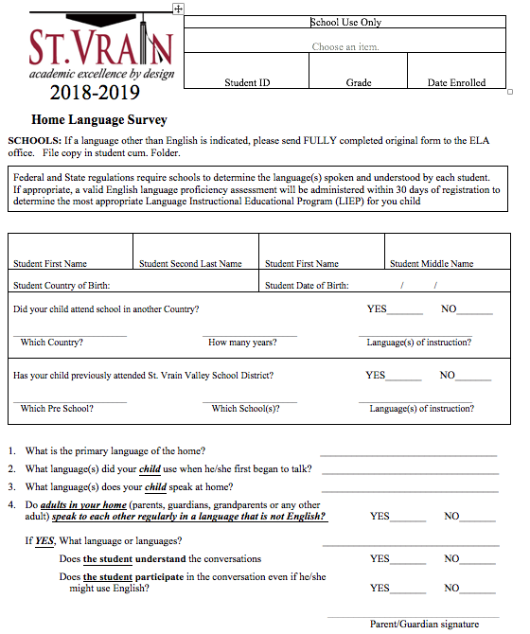
Home Language Survey
The home language survey (paper form and questions on the OLR) is the primary indicator that a student might need EL support. Therefore, it is a critical alert for our office to begin the process.
Whenever we are uncertain about the influence of a language other than English in the home, we will call families to gain more information

Slide 5
Home Language Survey
Federally required form
This form is critical to alerting the ELD Office of possible English Language Learners
Send to Sue Merriam if a language other than English is indicated on the survey
Bilingual Schools: indicating a language other than English does not automatically place a student in a bilingual classroom
Scan into email, fax to 303-682-7395 or district mail (ELD Office@LSC)
Please CC your ELD teacher when you send the language survey to our office
Include grade level and student ID#
Keep original in cum folder

Slide 6
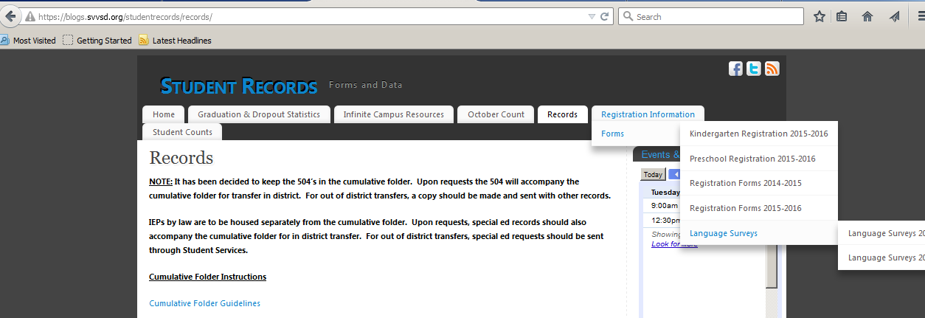
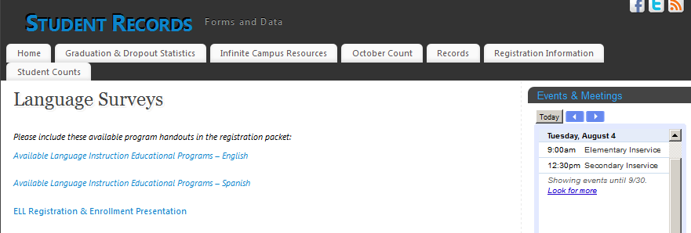
Language Instruction Educational Programs (LIEPs)
Notes:
https://blogs.svvsd.org/studentrecords/registration-information/forms/language-surveys/

Slide 7
Middle & High School Newcomers
The term “Newcomers” refers to any foreign-born students and their families who have recently arrived in the United States from a non-English speaking country. Newcomer students and families may be experiencing a variety of emotions about moving to a new country, learning a new language, making new friends, and navigating a new educational system. In accordance with state and federal law, it is our job to ensure that all students are made to feel welcomed and provided with high quality grade-level instruction.
All schools provide services for Newcomers who enroll within their attendance area.
Students should be enrolled as soon as possible. Please direct questions about any missing registration documents (immunizations, proof of residency, etc.) to the ELD office before delaying enrollment.
When a newcomer enrolls, contact your ELD teacher as soon as possible. ELD teachers have a welcome folder with information for families and can guide with course registration.
Notes:
As a team, please take some time to review federal guidance regarding the enrollment of students.

Slide 8
Enrollment & Records
from Board Policy JF: "students new to the District shall be enrolled conditionally until records, including discipline records, from schools previously attended by the student are received by the District"
from DOJ & OCR: “By choosing to wait to collect additional information that is not necessary for enrollment, districts can create a more welcoming atmosphere for all prospective students.”
from DOJ & OCR: “districts may not request information with the purpose or result of denying access to public schools on the basis of race, color, or national origin.”
Notes:
http://www.svvsd.org/files/policy/JF_0.pdf http://www2.ed.gov/about/offices/list/ocr/letters/colleague-201101.html
http://www2.ed.gov/about/offices/list/ocr/docs/qa-201101.html

Slide 9
Bilingual Liaisons
Schools with Biliteracy Programming: Bussing-Elementary
IF a family lives in the area of a non-bilingual school, but is interested in biliteracy programming (K-3), please have the family contact Ramona or Manuela to discuss their options
Every school has an ELD teacher & program options
Biliteracy - Spanish & English reading and writing
Manuela Chavez, Ext. 57559, East of Main
303-702-7559
Ramona Vasquez, Ext. 57312, West of Main
303-682-7312
*see notes section for specifics about which home schools are attached to which biliteracy schools
Notes:
Feeder schools with transportation to biliteracy sites if parent request biliteracy programming:
Columbine: Columbine serves students in their own boundary
Indian Peaks: Niwot, Eagle Crest, Blue Mountain, Burlington
Northridge: Sanborn, Lyons, Hygiene, Central, Mountain View, Longmont Estates
Rocky Mountain: Mead, Fall River, Alpine, Prairie Ridge, Centennial, Legacy, Black Rock, Erie, Red Hawk, Prairie Ridge, Highlands, Centennial, Legacy, Black Rock, Erie, Red Hawk, Thunder Valley
Timberline: Timberline serves students in their own boundary

Slide 10
Identification of EL students
Home Language Survey
Parent/guardian selects Bilingual or ESL services
WIDA Screener (a district trained person or school the ELD teacher administers the Screener)
Letter sent home
Identified EL students take ACCESS in January
EL tab in IC
Student Information > Program Participation > English Learner (EL)
Do not change “Home Primary Language” (under Census Demographics) back to English
EL student data is uploaded (including LSF or OLR, placement scores, and a copy of the letter that was sent to families) into the documents feature in the EL tab

Slide 11
WIDA Screener
Online language assessment for newly enrolled students
Results are upload into the EL tab (WAPT tab)
If you can, please let us know if:
Student is a newcomer
Student may need support from special education in order to take the test
Student has physical issues that may make taking the test online difficult
Sue Merriam, Data Specialist
Wendy Gonzalez, WIDA Screener & Data Specialist

Slide 12
Seal of Biliteracy & Transcripts
Qualifying students will need a Seal transcript, a gold SVVSD seal on their diploma, and a purple cord for graduation. Gold diploma seals and cords will be provided to each school. Transcripts need to indicate that the student received the seal as well as the language that they qualified in. Contact Amber for more information about transcripts.

Slide 13
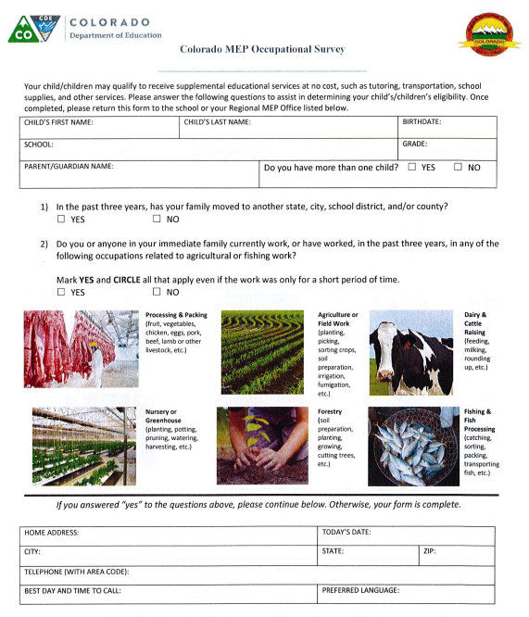
Send Migrant surveys to the ELD Office ℅ Sue Merriam

Slide 14
ELD Office Contacts
Sue Merriam: Ext. 57389
Wendy Gonzalez: Ext. 57526
Oakley Schilling: Ext. 57512
Janette Rivera Gonzalez: Ext. 57202
Patrick Kilcullen: Ext. 57434

