Slide 1
Health & Registrar Clerk Collaboration
Notes:
Content Overview

Slide 2
Agenda
HEALTH CONDITIONS
STUDENTS
MEDICATIONS
IMMUNIZATIONS

Slide 3
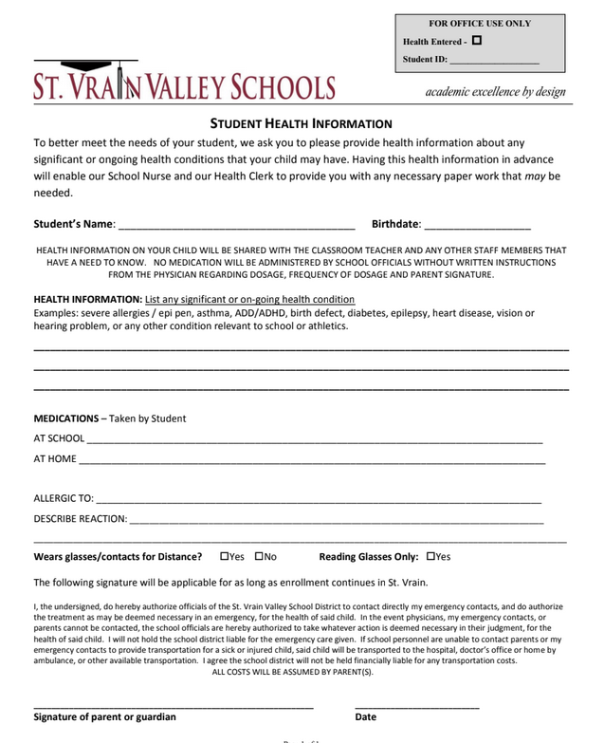
HEALTH CONDITIONS
ST. VRAIN HEALTH FORM (SVHF)
Notes:
1 PER STUDENT FOR THE DURATION OF ENROLLMENT IN SVVSD
HARD COPY

Slide 4
ONLINE REGISTRATIONS (OLR’s)

Slide 5
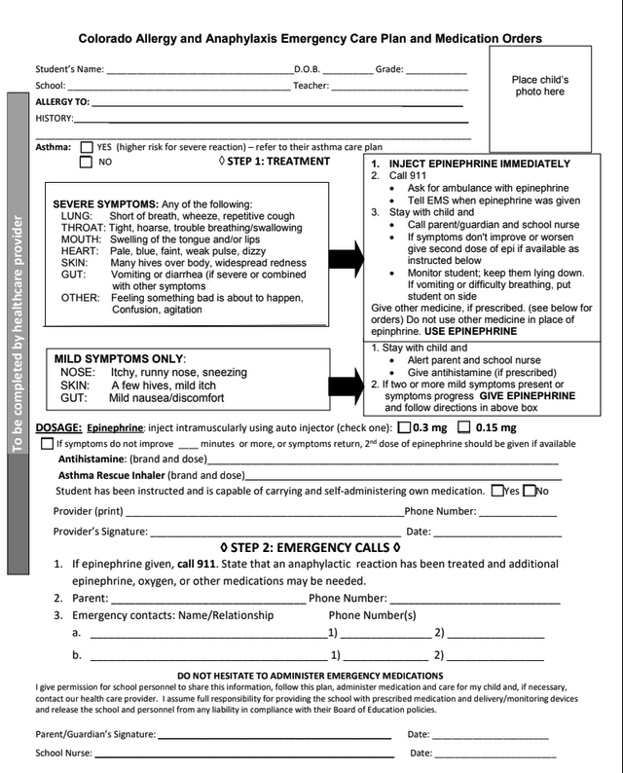
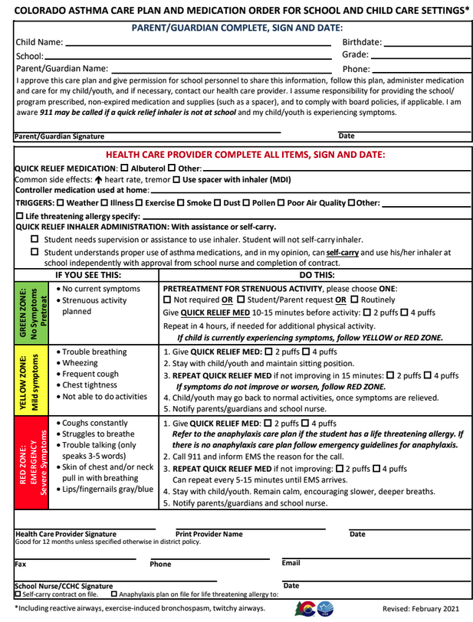
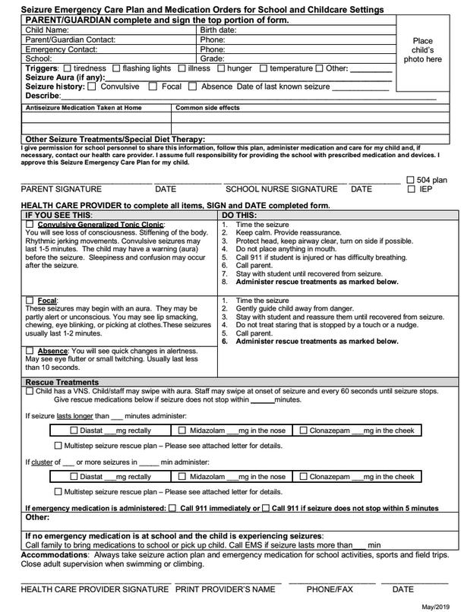
INDIVIDUAL HEALTH PLAN (IHP) FORM

Slide 6
DOCUMENTATION PROVIDED BY
Parent/Guardian
Doctor
Hospital
Urgent Care/Clinic
Athletic Trainer

Slide 7
MEDICATION
ONLINE REGISTRATIONS (OLR’s)

Slide 8
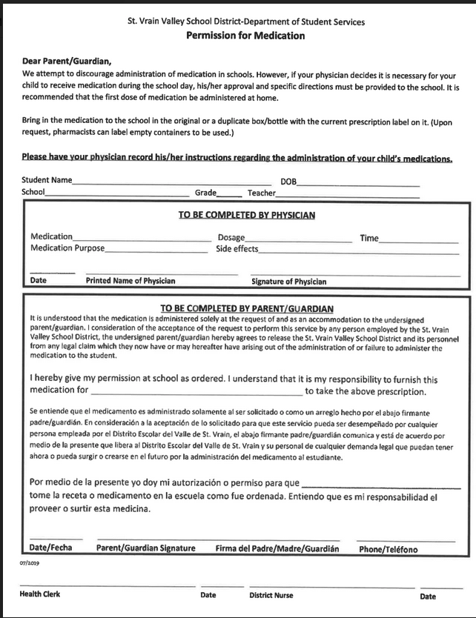
PERMISSION TO MEDICATE (PTM) FORMS

Slide 9
IMMUNIZATIONS
ONLINE REGISTRATION (OLR’s)

Slide 10
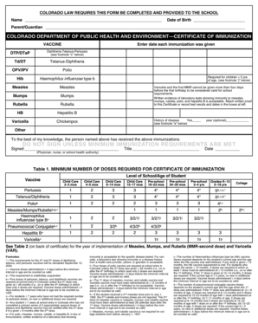
DOCUMENTATION PROVIDED BY
Parent/Guardian
School Records
Doctor/Hospital/Clinic

Slide 11
QUESTIONS

