Slide 1
Gifted & Talented
Services
An Overview for Registrars

Slide 2
—SOMEONE FAMOUS
“This is a quote, words full of wisdom that someone important said and can make the reader get inspired.”
Notes:
This deep and meaningful quote came with the slideshow template.

Slide 3
01.office Contacts
02. Terminology
05. Early Access
03. Portability
04. Referrals
Gifted Services Office Contacts.
Previously “Nominations”.
Brief summary of terminology.
Advanced access to Kindergarten or 1st grade.
Transferring GT records between schools.

Slide 4
01.
Office Contacts

Slide 5
x57808
Connie Moreno
Jaimarie Nelson
Jennifer Mayer
Marissa Squires
Secretary Secretary Coordinator Coordinator
Portabiltiy Data
Early Access Spreadsheets

Slide 6
02.
Terminology
Frequently used terms.

Slide 7
Terminology
Body of Evidence
ALPs
Portabilty
Advanced Learning Plan; reviewed and updated annually
Testing scores used to make ID determinations
Transferring of GT determination/documents between schools

Slide 8
03.
Portability

Slide 9
Portability TIMELINE
STEP 01
STEP 03
Data is submitted to Coordinators for Review
GT Office Receives OLR
STEP 02
STEP 04
Our office reaches out to the previous school’s GT Dept
If approved, our office adds a flag in I.C. and notifies the family and GT Site Leader.
Notes:
Key points: Our office does this work. Not on the slide: thoughts on how registrars can help (ex. Parent hands them GT records or assessments they don’t recognize, contact our office). Modify based on Connie’s preferences.

Slide 10
Notes about portabilty
01
All documents must be reviewed and approved by our office before portability is transferred.
02
ALPs are similar to IEPs in that they are reviewed annually, and the state Colorado has regulations regarding transfer timelines and assessments.
03
04
Outgoing Portability has a form.
ALPs are not currently stored in CUM folders.

Slide 11
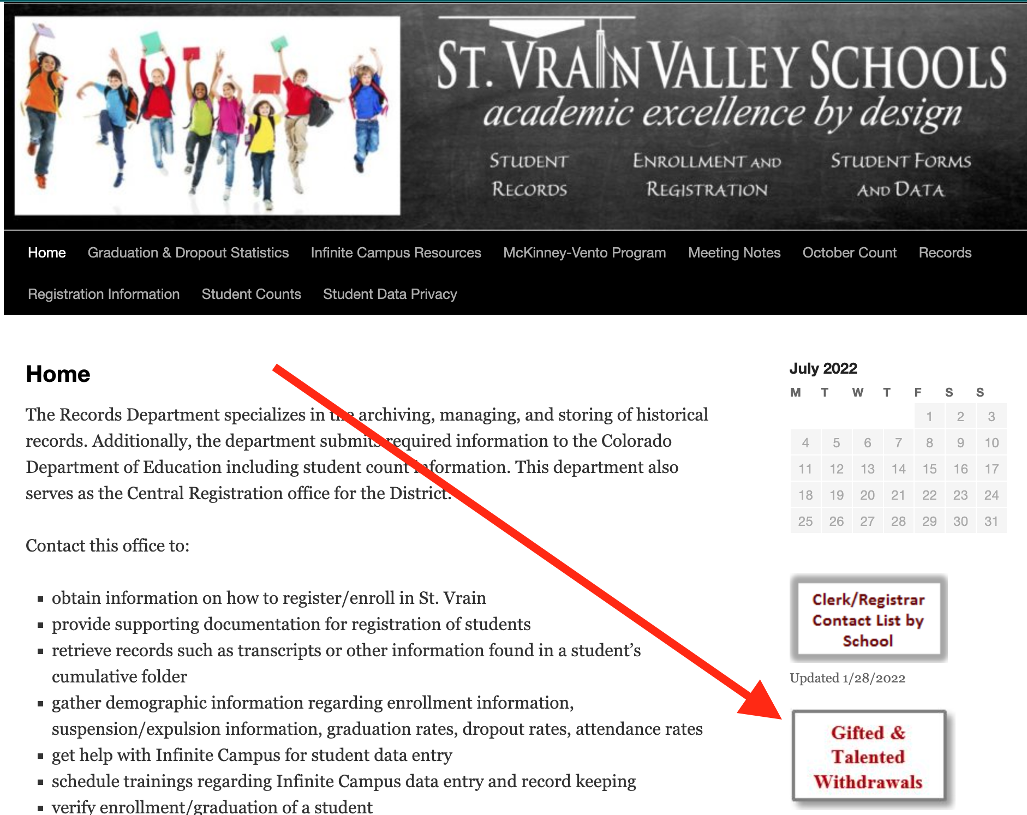
Portability
Leaving SVVSD
Notes:
If a parent tells you they are moving to another school in another school district and they have the GT flag in Infinite Campus, please have the parent complete the Gifted and Talented Withdrawals form. Our office will receive this information and we will send the appropriate documentation to the receiving district.

Slide 12
DO Not Edit Flags
If you have questions call our office.

Slide 13
04.
Referrals
Previously “Nominations”

Slide 14
Referrals
Link opens up in Fall and is available for a month.
Teachers and Parents can use the link to nominate a student in any of our 11 areas.
More information to come
Notes:
Previously, the term used was “nomination”. Students can also nominate themselves.

Slide 15
05.
Early Access
To Kindergarten and 1st Grade

Slide 16
Early Access
A pathway for highly advanced students to move to Kindergarten or 1st grade earlier than their peers.
This is NOT the path for a majority of students who miss the Oct 1st cut off date.
Additional information is on our website. Encourage parents to view the website first, then call our office with additional questions.
Notes:
The most important point for registrars is that this is NOT for students who miss the October 1st cut off date for Kindergarten.

Slide 17
KEY
Concepts

Slide 18
Key CONCEPTS
01.
Call or email with questions
Flags and IDs are handled by our office
02.
03.
GT Records are not currently stored in CUM folders
Early Access is not for most students, please direct parents to our website first.
04.
05.
If a student identified as GT in Infinite Campus is moving to another school district, please inform us.

Slide 19
THANKS!
Please keep this slide for attribution

