Slide 1
SCHEDULING REFRESHER
Elementary Schools
Beginning of the Year

Slide 2
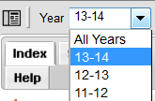
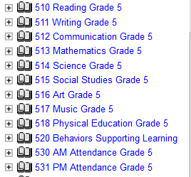
Ready for the New Year?
Change year to 22-23
*Reminder, the 21-22 school year is still in “edit” mode until September.*
Click “Search” Tab > Course/Section > Go

Slide 3
Scheduling Changes
Courses/Sections

Slide 4
Courses/Sections
Click on the “>” sign to open up a course to see sections with teacher names and room numbers
Please contact Learning Services Specialists to add staff and/or room numbers

Slide 5
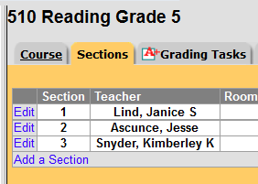
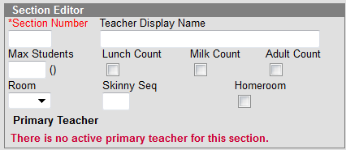
Adding A New Section
Click on Course Name > “Sections” tab > Add a Section
Must give section a number; everything else is optional on card
AM Attendance Sections are to be marked as “Homeroom”

Slide 6
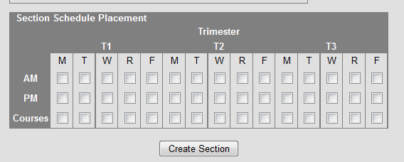
All created sections (except for AM and PM Attendance) must have check marks in “Courses” under Section Schedule Placement
AM and PM Attendance must have check marks in AM and PM respectively in the Section Schedule Placement box.

Slide 7
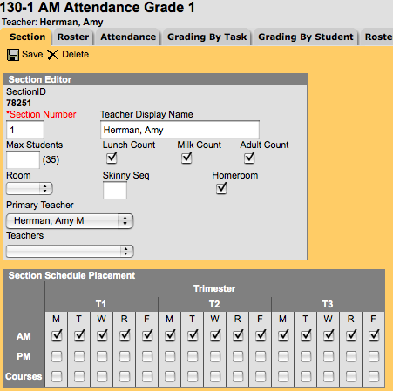
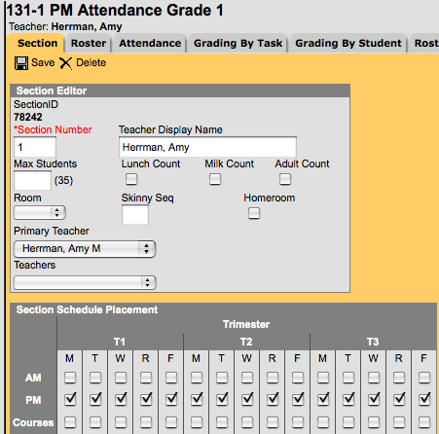
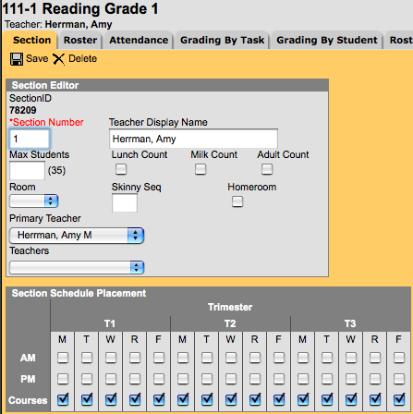
AM/PM/Courses
Course cards should look like the above when completed correctly.
From left to right: AM Attendance, PM Attendance, and Courses (Reading, Writing, Communications, Mathematics, Science, Social Studies, Art, Music, PE, Supporting Behaviors and Overall Comments)

Slide 8
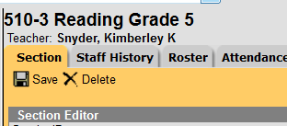
Deleting A Section
Click on the word “Edit” next to the Section to delete
Click “Delete” on Section tab.
Click “OK” when question box appears asking if you are sure.
**When deleting sections, make sure you delete sections of all courses that the teacher was responsible for grading

Slide 9
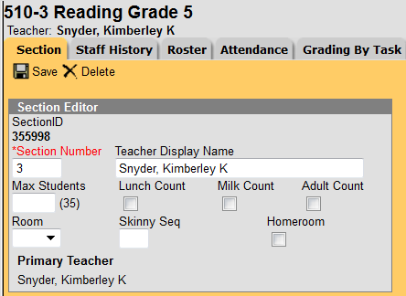
Changing A Section
If same number of sections in a grade level for next school year and a change in room number or teacher name is all that is needed--
Open up the course, click on the section that requires a change. . .
Remember
to Save

Slide 10
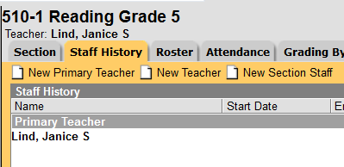
Changing A Section Primary Teacher
Click on the Staff History tab
Click on the teacher’s name
currently on the tab
Click “Delete”
Click Okay
Click New Primary Teacher
Choose new teacher from drop down list
“Use a new Teacher Display Name on the Section Tab” should be selected
Click Save

Slide 11
Rostering
Courses/Sections

Slide 12
Rostering Students
Students should be rostered into one of the “AM Course” sections.
Rostering in to the other sections is a school decision. There are Pros and Cons either way.
Specials Teachers have their rosters: Pro
Done (reduce beginning of year chaos): Pro
Ability Grouping (redo certain sections): Con
Schedule Changes: Con
Two ways to roster students into all other sections: Roster Setup Tab or Scheduling > Roster Copy

Slide 13
Rostering into AM Attendance
Click on AM Attendance Section > Roster Setup
Choose student grade level from drop down box
Click on student name and moves to left box

Slide 14
Roster Set Up Tab
After rostering students into AM Attendance. . .
Click on section needing roster
Click on “Copy Students from this Section (Choose AM Attendance)
Click Save
Continue until all courses have been rostered
Roster Setup will be turned off September 15th.

Slide 15
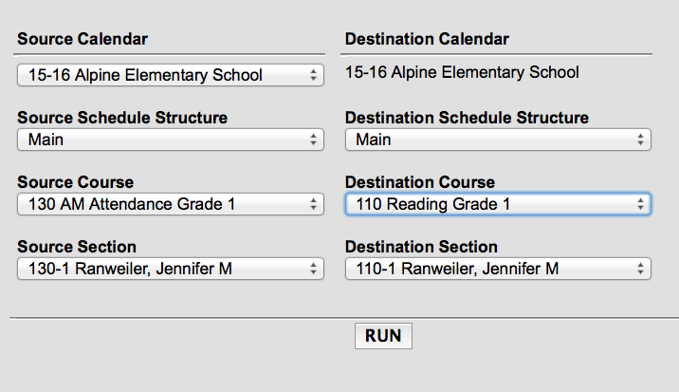
Roster Copy
After rostering students into AM Attendance. .
Click on Index > Scheduling > Roster Copy
Source Calendar is 20-21 and School Name (should match Destination Calendar
Source and Destination Schedule Structure is “Main”
Source Course is Attendance
Destination Course is Reading, Writing, etc.
Source Section Number and Destination Section number should match.
Click “Run.”

Slide 16
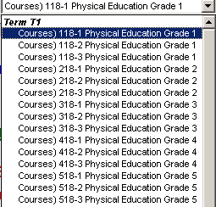
Help Specials Teachers Out
Provide Specials Teachers with a list of section numbers for each grade level and the teacher associated with that section number
Specials Teachers see:
Provide them with a list that shows:
118-1 Smith’s class
118-2 Murphy’s class
118-3 Jones’s class

Slide 17
Important Dates for 15-16
Scheduling staff will have access to the 22-23 school year in January
Teachers will have access to the 22-23 school year Jun 1, 2022
The 21-22 school year becomes Read Only the September 15th.

Slide 18
Questions, Concerns, Discussions

